Slide 1
“Hey That’s Not Fair!”
Where is my Due Process

Slide 2
Todays Routine
Self Assessment
Guided notes
Small Groups Case Analysis and Discussion
Whole Class Case Analysis
Follow up Reflection

Slide 3

Remember:For Every Action there is a
Reaction

Slide 4
4th Amendment
The right of the people to be secure in their persons, houses, papers, and effects, against unreasonable searches and seizures, shall not be violated, and no Warrants shall issue, but upon probable cause, supported by Oath or affirmation, and particularly describing the place to be searched, and the persons or things to be seized.

Slide 5
5th Amendment
No person shall be held to answer for a capital, or otherwise infamous crime, unless on a presentment or indictment of a Grand Jury, except in cases arising in the land or naval forces, or in the Militia, when in actual service in time of War or public danger; nor shall any person be subject for the same offence to be twice put in jeopardy of life or limb; nor shall be compelled in any criminal case to be a witness against himself, nor be deprived of life, liberty, or property, without due process of law; nor shall private property be taken for public use, without just compensation.

Slide 6
6th Amendment
In all criminal prosecutions, the accused shall enjoy the right to a speedy and public trial, by an impartial jury of the State and district wherein the crime shall have been committed, which district shall have been previously ascertained by law, and to be informed of the nature and cause of the accusation; to be confronted with the witnesses against him; to have compulsory process for obtaining witnesses in his favor, and to have the Assistance of Counsel for his defence.

Slide 7
Due Process Clause
Amendment XIV
…No State shall make or enforce any law which shall abridge the privileges or immunities of citizens of the United States; nor shall any State deprive any person of life, liberty, or property, without due process of law; nor deny to any person within its jurisdiction the equal protection of the laws.

Slide 8
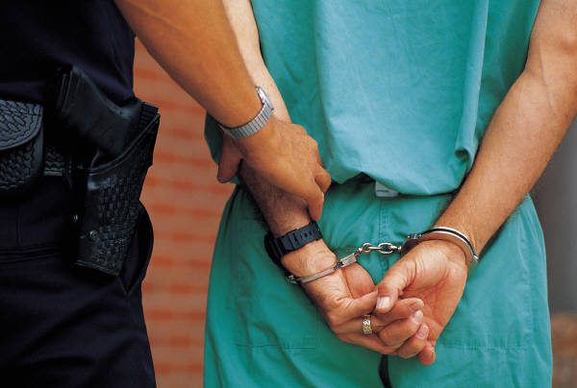
Steps In Due Process
Reasonable Suspicion
Probable Cause
Arrest
Booking
  Finger print
  Photo
  Possible DNA
Arraignment
  Guilty
  Not Guilty
  No Contest

Slide 9
Which Court Do I Go To?
Magistrate
  30 days up to 1 year
  Jail
  Misdemeanors
    Three classes
Circuit Court
  1 year or more
  Prison
  Felonies
    Six classes

Slide 10
SC Court Statistics
Magistrates Court
  Total Cases Filed
  938,060
  Total Cases Disposed 889,940
  310 Magistrates
Do the Math:
938,060 / 310 =
3,026 cases per Magistrate
Circuit Court
  Total Cases filed 232,741
  Total Cases Disposed 229,311
  46 Circuit Court Judges
  Do the Math:
  232,741/46 =
  5,060 cases per Judge

Slide 11
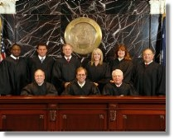
Court of Appeals
Review By Certiorari
  Reverse lower court decision
Cases filed: 1,664
Cases Disposed: 1,632
Do the Math:
1,632/3 =
544

Slide 12
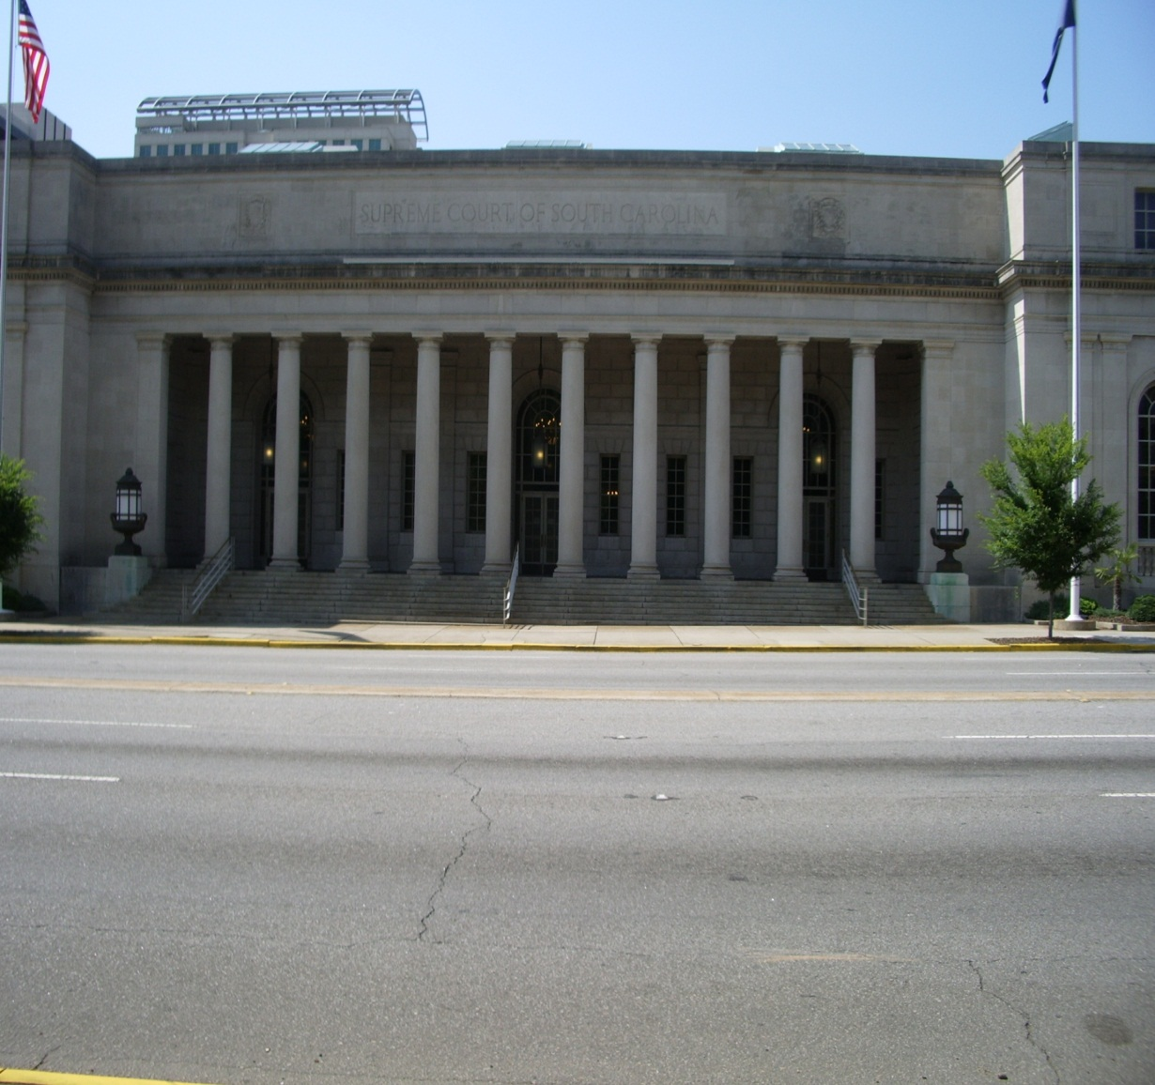
South Carolina Supreme Court
5 Judges
  1 Chief Justice
  4 Associate Justices
Matters Filed: 1,427
Matters Disposed: 1,566

Slide 13
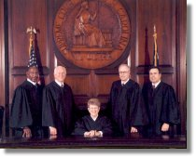
South Carolina Supreme Court Justices

Slide 14
Small Groups Case Analysis and Discussion
Teacher Handout
Groups of three or four

Slide 15
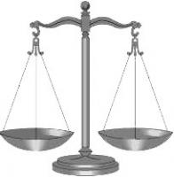
Whole Class Supreme Court Analysis
Mapp v. Ohio

Slide 16
Follow Up Reflection Activity

