Slide 1
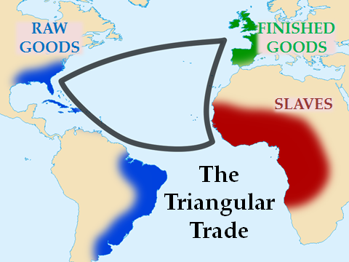
Causes of the Revolution
MERCANTILISM - exporting goods (selling goods to other nations) more than they import (buy goods from other nations)
desire for more land
Exporting raw materials to England so they could export finished goods

Slide 2
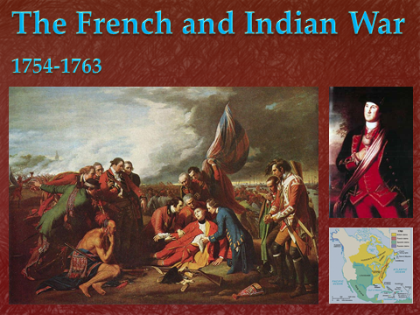

Slide 3
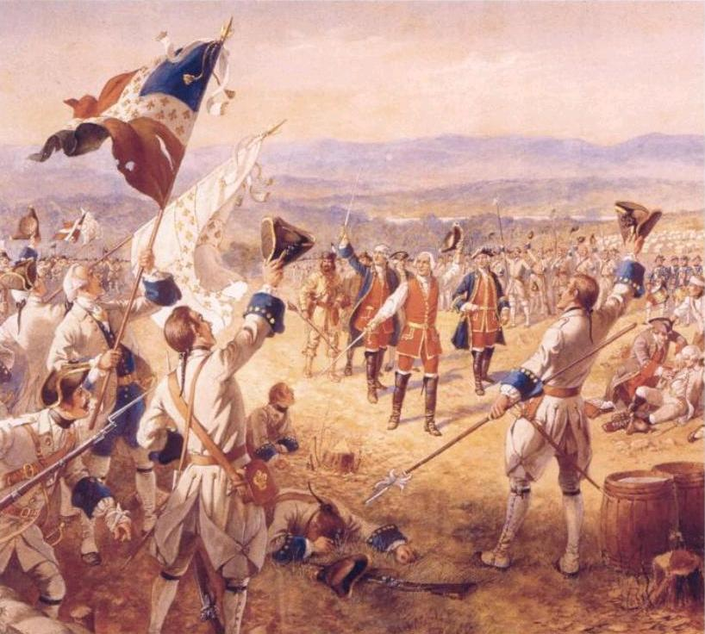
British colonist moved west
Fighting French and Native Americans
9 years of fighting
French surrendered and gave up its claims in Canada and all lands east of the Mississippi River
Significance was Great Britain stood alone as the one true colonial power in North America

Slide 4
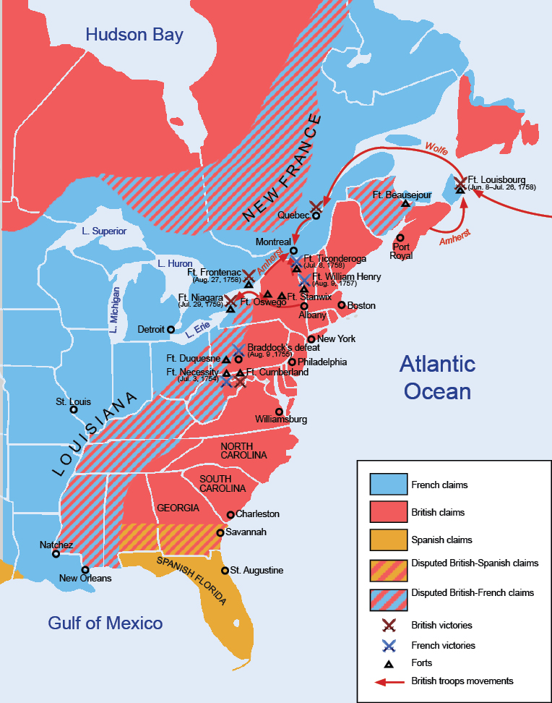

Slide 5
Tension Between Great Britain and the Colonies
Colonist lost respect for Britain’s Military (ill-prepared and unsuited for fighting on the American terrain)
Great Britain was heavily in debt after fighting to protect its colonies (felt Americans should help pay for the expense)
Which all lead to…1760 England began issuing writs of assistance, General search warrants that allowed British authorities to search whatever they wanted for whatever reason
This enforced the Navigation Acts

Slide 6
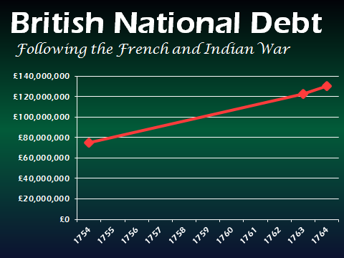

Slide 7
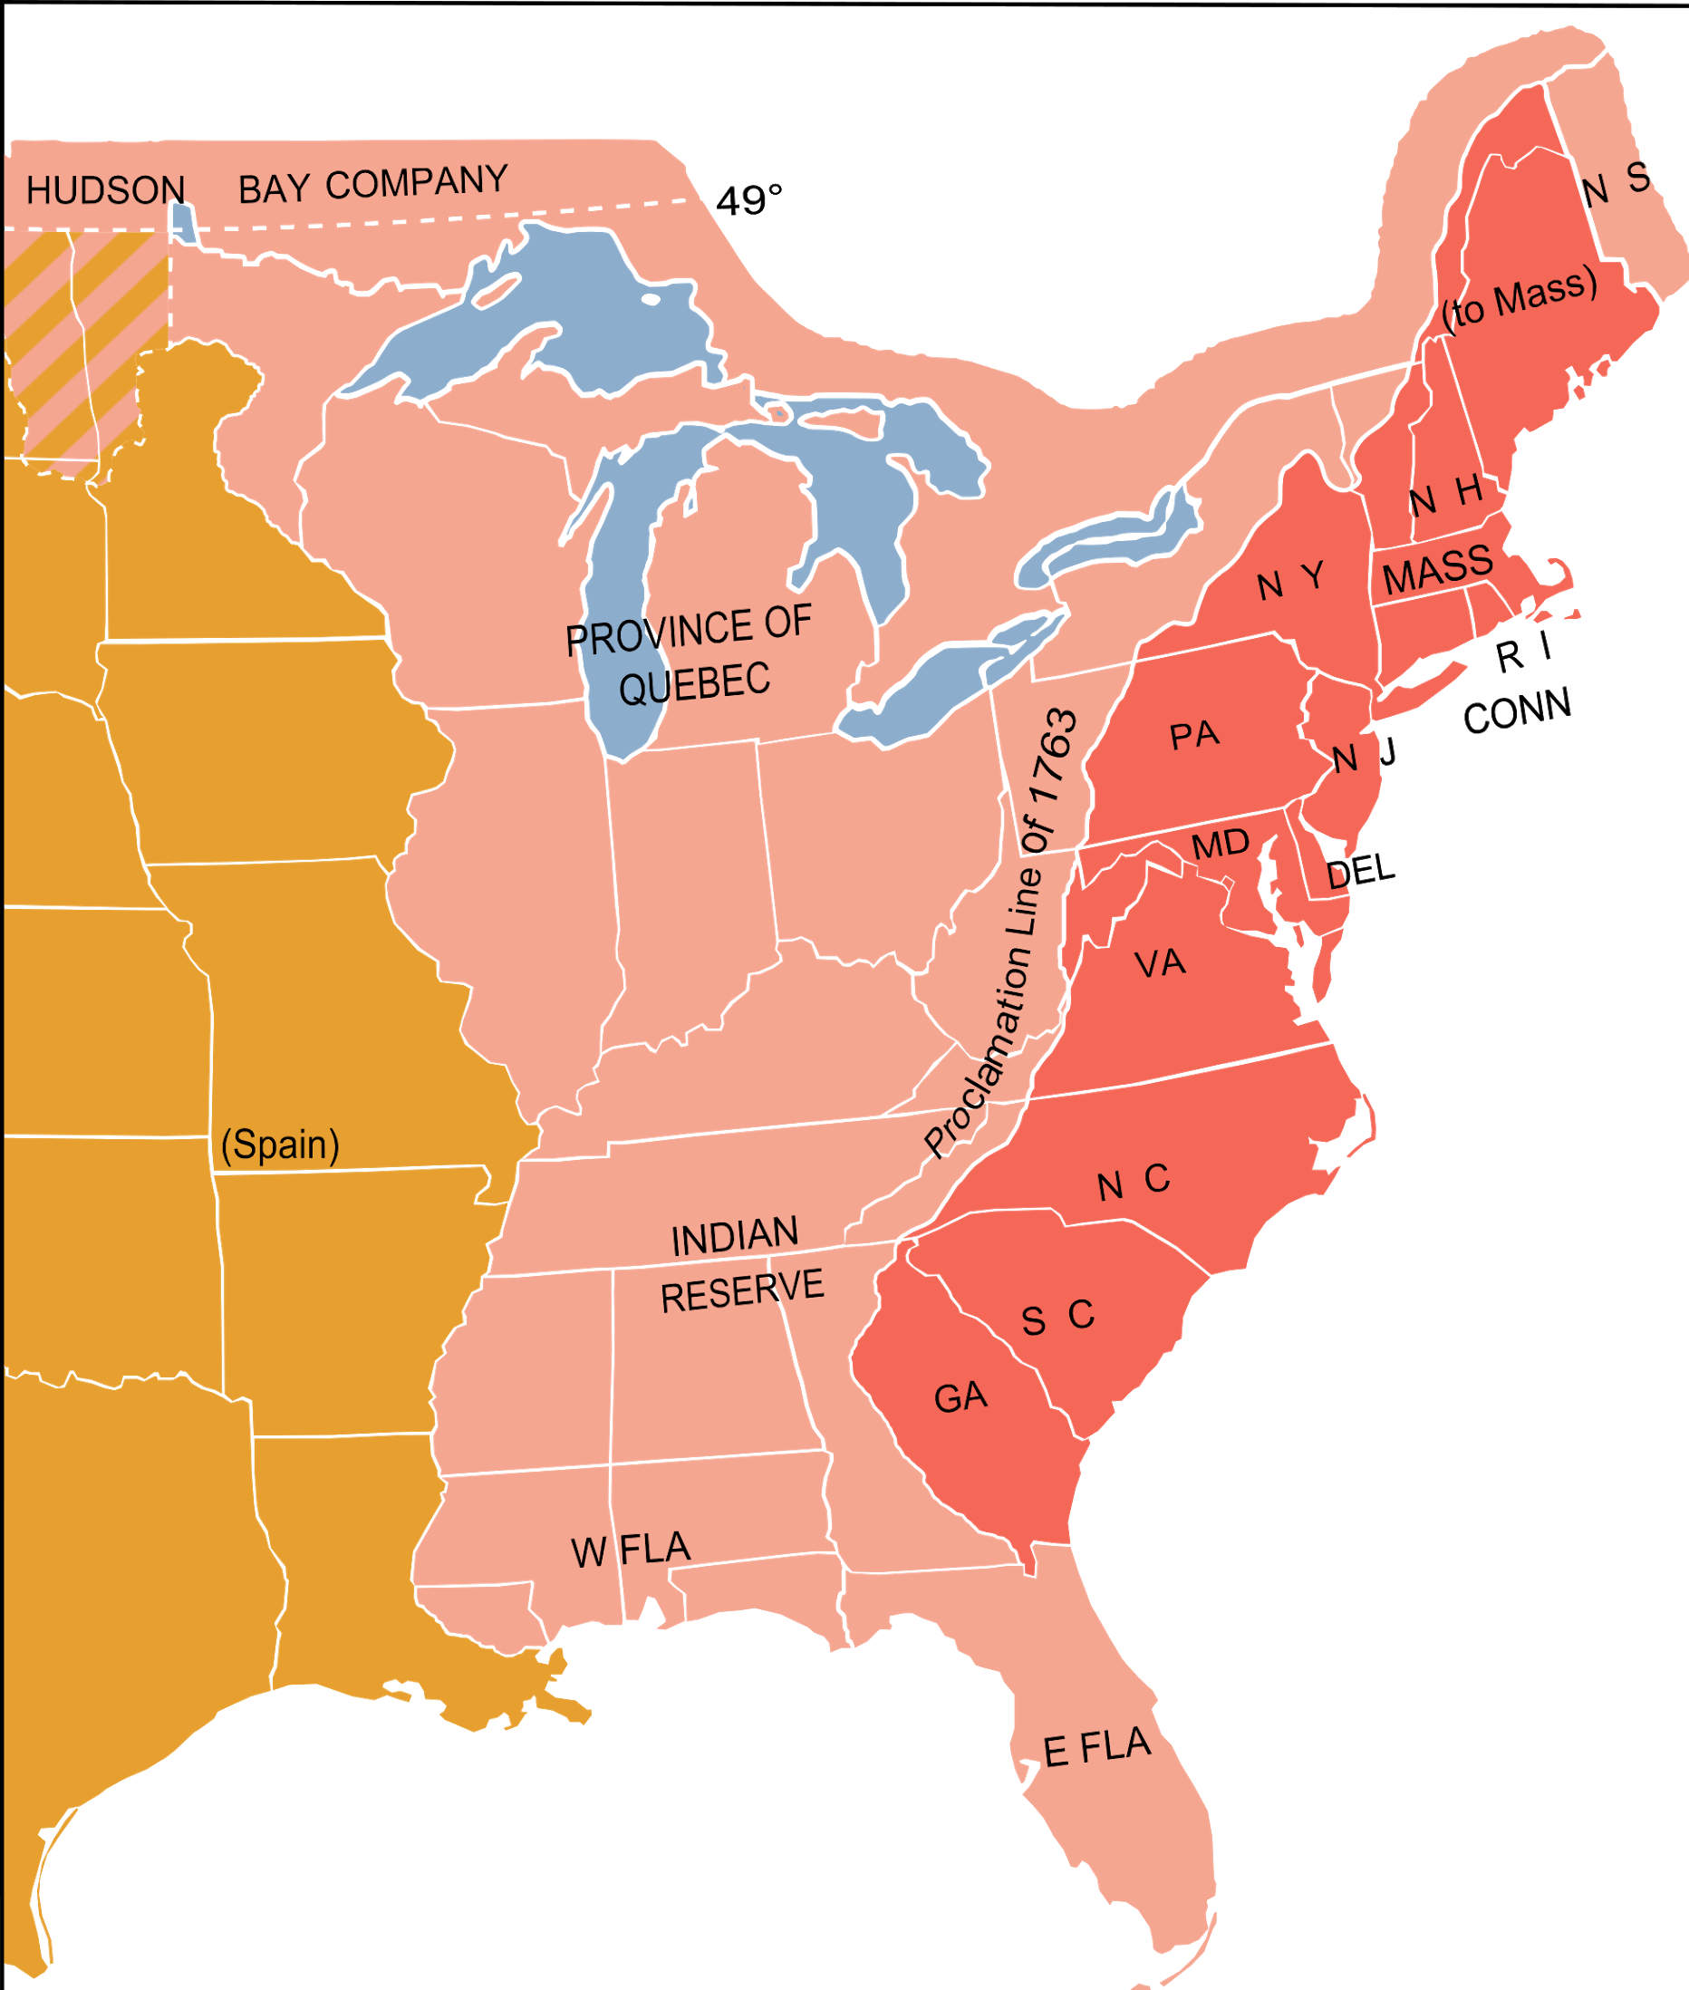
Navigation Acts - was a series of laws that restricted the use of foreign ships for trade between the colonies and any country except Britain
Proclamation of 1763 - forbide colonist from settling west of the Appalachian Mountains; also put the territory under British military control
Colonists resented King’s restrictions and many ignored the proclamation

Slide 8
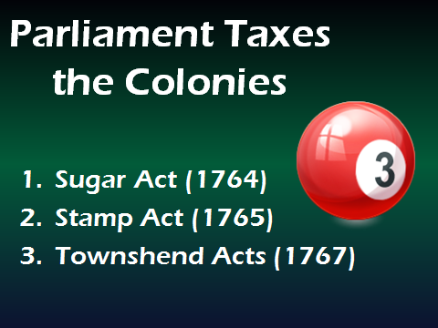
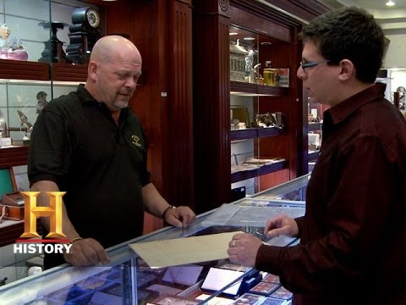

Slide 9


Slide 10
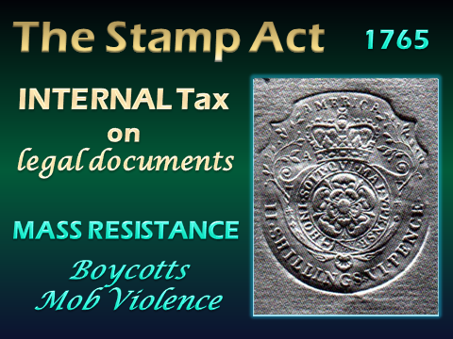

Slide 11
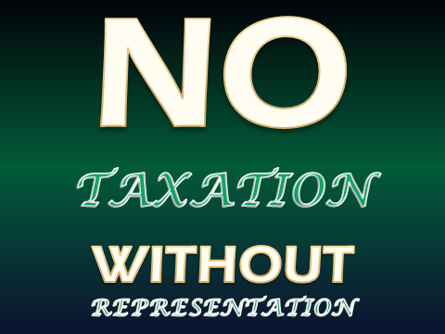

Slide 12
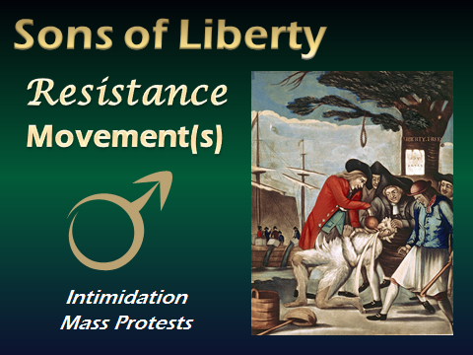

Slide 13
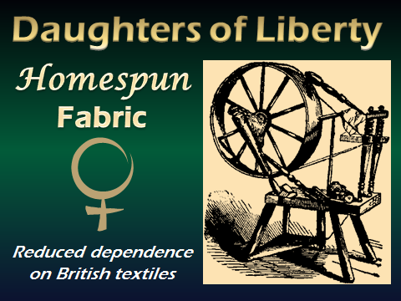

Slide 14
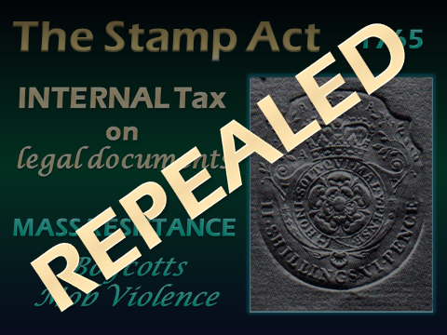

Slide 15

Declaratory Act
Parliament had the
authority to impose laws on the colonies

Slide 16
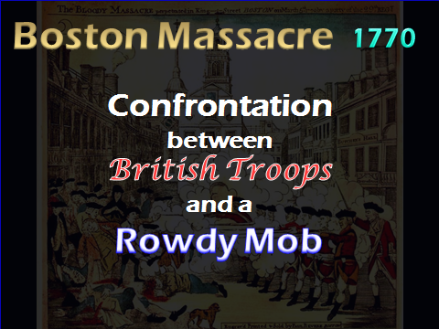

Slide 17
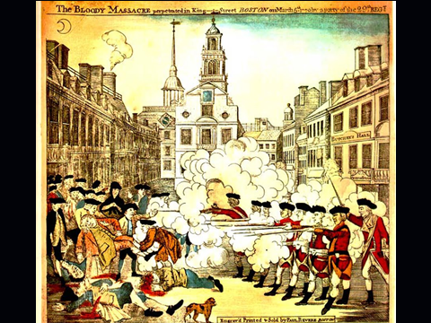

Slide 18
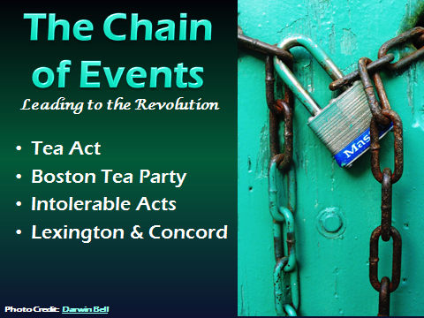

Slide 19
Intolerable Acts - closed the British Harbor and placed a military governor over Massachusetts
England also expanded Canadian border, taking land away from certain colonies
Sept 1774 First Continental Congress, statement to the King, Congress wrote that the colonists had a right to be represented in their government (not rep in Parliament, were entitled to govern themselves
1775 Lexington and Concord - fighting broke out, British troops were on their way to seize arms and ammunition stored by colonists at Concord, Massachusetts
Met at Lexington by colonial militia (voluntary, local military units consisting of private citizens rather than full time soldiers)
Someone (know one knows) fired the “shot heard around the world” THAT STARTED THE AMERICAN REVOLUTION

Slide 20


Slide 21
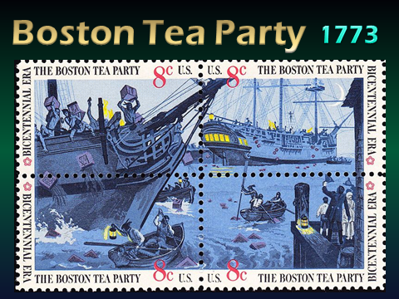

Slide 22
