Slide 1


Landlord/Tenant 101
Step by Step Process to Fighting Common Landlord/Tenant Issues

Slide 2
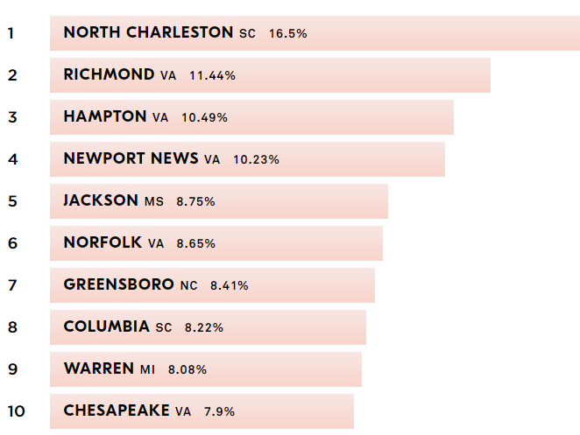
Eviction Defense
Summary of a Summary Process

Slide 3

A Word About Subsidized Housing
How to Recognize Subsidized Housing
Your client has to report their income to their landlord or to a housing authority.
Your client’s rent changes if their income changes.
Your client has some kind of relationship with a housing authority.

Slide 4
Call Someone!
More Defenses Available
Possible Affirmative Claims
Eviction Means:
  Loss of rent subsidy
  Barred from other subsidized housing for years (or permanently)

Slide 5
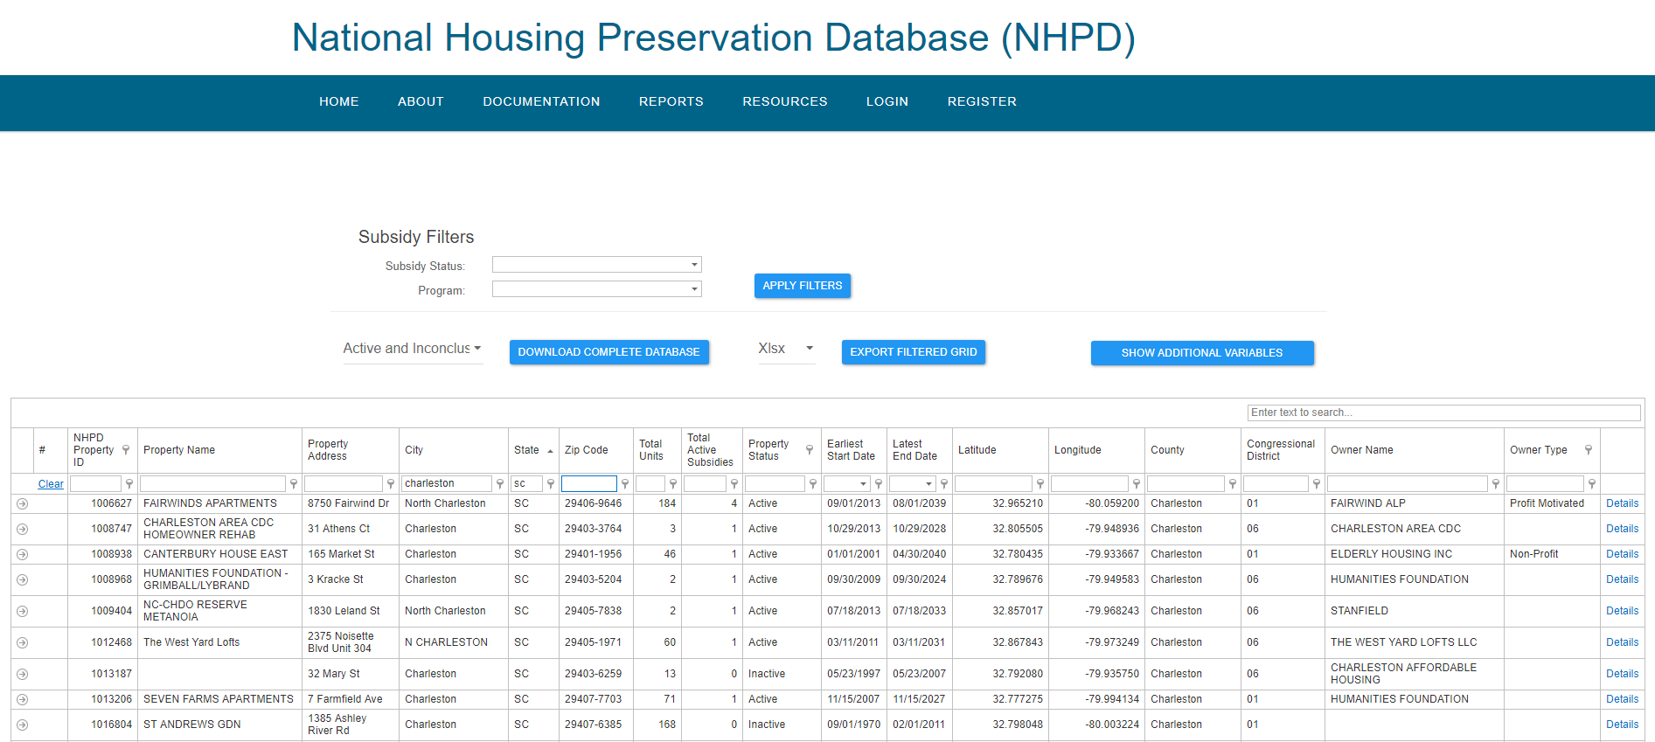
https://nhpd.preservationdatabase.org

Slide 6
A Two-Step Process
Landlord terminates the lease, but tenant remains in possession
1
Landlord may file an action to eject the tenant
2

Slide 7
The Bare Necessities
A Landlord-Tenant Relationship
The summary ejectment statute is applicable only where a landlord-tenant relationship actually exists and the Magistrate lacks jurisdiction to hear the case unless that relationship exists. See Stewart-Jones Co. v. Shehan, 127 S.C. 451 at 455-56 (1924); Baldwin v. Baldwin, 224 S.C. 429 at 431 (1954).
See also Mountain View Baptist Church v. Burdine, 2013-MO-009 (S.C. Sup. Ct. filed March 13, 2013) (noting that the existence of a landlord-tenant relationship is a prerequisite to the magistrate’s exercise of jurisdiction in ejectment proceedings)*
*This is an unpublished opinion with no precedential value. This is also a shameless plug for a case litigated by SCLS’ own Michael Gambrell and Kirby Mitchell.

Slide 8
A Landlord-Tenant Relationship
What it is
What it ain’t
Very broad – covers most agreements where one person uses land owned by another.
No written agreement required
No express agreement required
Payment of rent not required
  See Bruce v. Durney, 341 S.C. 563 (S.C. App., 2000) (taking a walk through the elements)
Rent to own, bond for title, agreement for deed, lease with option (sometimes), etc.
If there’s a question of title to real property (adverse possession, marital interest, etc.)

Slide 9
Service of Process
Three ways to do this
Personal service (including cert. mail restricted)
Posting at the property if it’s been abandoned
Posting + regular mail
  Two unsuccessful attempts at personal service
  Clerk mails the pleadings
  10 days to answer starts on the 11th day after mailing

Slide 10
Grounds for Eviction
Failure to pay rent
Violating terms of the lease (materially)
The lease term has ended

Slide 11
Failure to pay rent
Landlord must give 5 days’ written notice and opportunity to cure before filing
Landlord’s failure to make repairs can be a counterclaim
Make sure what landlord is charging for is actually “rent”

Slide 12
Lease Violations
Landlord has to give 14 days’ written notice and opportunity to cure
If Tenant cures the violation within 14 days (or proceeds in good faith to cure but it takes longer), the lease does not terminate.
Violation needs to be material. Make ‘em prove it.
Certain Landlord rules may not be enforceable.

Slide 14
End of Lease Term
Landlord needs to give 30 days’ notice before terminating for this reason
Generally can’t be used in subsidized housing (need good cause to terminate)
Maybe can’t be used in mobile home parks?

Slide 15
Procedural Defenses
12(b)(6) - Rule to Vacate and/or Application for ejectment don’t state facts
Look for checkboxes
Bad notice/lack of opportunity to cure

Slide 16
Common Cases
Nonpayment + Tenant Counterclaim for Failure to Repair
Tenant can counterclaim for actual damages (reduction in rental value) IF Landlord had notice of need for repairs before rent is due
Can recover attorney’s fees if Landlord’s conduct is willful
May be unlawful ouster if Landlord has excluded tenant from the property or willfully reduced essential services (power, water, etc.)
  Three months’ rent damages to tenant + attorney’s fees

Slide 17
Common Cases
Retaliation for Tenant Complaints
Landlord retaliates against tenant for protected conduct by
  Raising rent beyond fair market value;
  Decreasing essential services
  Filing for eviction
Protected conduct is
  Complaining of a violation affecting health/safety to code enforcement
  Complaining to the Landlord of a violation of the LL/T Act
Damages
  Up to 3x monthly rent to tenant
  Attorney’s fees

Slide 18
Prohibited Lease Provisions

Slide 19

Retaliation?
Tenant:
Landlord:

Slide 20
Tips
Doesn’t matter what the lease says, the SCRLTA wins.
Preserve your record!
What “relaxed rules of evidence” means is unclear.
Jury trials can be an advantage (just request them on time)
Appeals are essentially de novo by statute, but errors of law win.
There is no “bond” required on appeal, only an undertaking to pay rent.

Slide 21
Conditions Cases
So, your client needs a fix…

Slide 22
Background
“habitability is defined as the ‘[t]he condition of a building in which inhabitants can live free of serious defects that might harm health and safety . . .’.”
Roland v. Heritage Litchfield, Inc., 372 S.C. 161 (Ct. App. 2007)
“there is no implied warranty of fitness or habitability in leases.” Young v. Morrisey, 285 S.C. 236 at 239-240 (1985).
A big exception – The SCRLTA adopted in 1986

Slide 23
Landlord Obligations Under the SCRLTA
Comply with applicable building/housing codes materially affecting health and safety;
Do whatever is reasonably necessary to put and keep the property in a fit and habitable condition;
Keep common areas reasonably safe and clean;
Make running water, hot water, and reasonable heat available;
Maintain in safe and working order all electrical, gas, plumbing, sanitary, heating, ventilating, air conditioning, and other appliances supplied or required to be supplied by him.
Make essential services available including sanitary plumbing or sewer services; electricity; gas, where it is used for heat, hot water, or cooking; running water, and reasonable amounts of hot water and heat.

Slide 24
What Triggers T’s Right to Sue?
Problems materially affecting health and safety or the physical condition of the property. 27-40-440
Other problems?
  We hold that the act permits a tenant to recover damages, including diminished rental value, for a landlord's breaches of statutory duties, regardless of whether those breaches are "material" or involve "essential services."
  Sullivan v. Subramanian, 2 P.3d 66 (Alaska 2000) (a URLTA state)
  So, “materially affecting health and safety” may only matter if you’re trying to get out of the lease.

Slide 25
Materially Affecting Health and Safety
Presence of toxic mold - Roland v. Heritage Litchfield, Inc., 372 S.C. 161 (Ct. App. 2007) (implied warranty of habitability case)
Stairs to T’s front door collapsed - Watson v. Sellers, 299 S.C. 426 (Ct. App. 1989)
Inoperative toilet - Schaefer v. Murphey, 131 Ariz. 295 (Ariz. 1982)
Peeling lead paint accessible to infant - Henderson v. Vann, 43 Va. Cir. 392 (Va. Cir. Ct. 1997)
No front door lock - Brichacek v. Hiskey, 401 N.W.2d 44 (Iowa 1987)
Raw sewage spilling on the ground, unsafe drinking water - Mathes v. Adams, 254 Mont. 347 (Mont. 1992)
Only source of drinking water came by garden hose running above ground from neighboring house - Mathes v. Adams, 254 Mont. 347 (Mont. 1992)
Receiving a shock when touching parts of the plumbing - Mathes v. Adams, 254 Mont. 347 (Mont. 1992)
Wooden walkway with no hand railing and no “anti-slip” material - Newton v. Magill, 872 P.2d 1213 (Alaska 1994) (summary judgment for LL improper)
Carbon monoxide poisoning due to furnace leak - Kunst v. Pass, 1998 MT 71 (Mont. 1998)
Tenant fell through stairs in common area - Marple v. Papermill Park Corp., 30 Va. Cir. 154 (Va. Cir. Ct. 1993)

Slide 26
More
Exposed electrical wiring and loose uncovered outlets - Joe v. Spangler, 6 Kan. App. 2d 630 (Kan. Ct. App. 1981)
Deteriorated deck railings - Cromer v. Johnson Vill., L.L.C., 68 Va. Cir. 442 (Va. Cir. Ct. 2005) (Summary judgment for LL improper)
City posted notice that all tenants had to vacate due to dangerous conditions - Thueson v. Swinger, 2006 MT 250N (Mont. Oct. 3, 2006)
Gas lines that didn’t comply with code - Parson v. Wooded Lake Mobil Home Park, 495 N.W.2d 140 (Iowa Ct. App. 1992)
Defective heating stove/ventilation - Jackson v. Wood, 11 Kan. App. 2d 478 (Kan. Ct. App. 1986) (duty also runs to T’s guests)
Defective HVAC system - Stone v. Linden Real Estate, Inc., 2009 OK CIV APP 47 (Okla. Ct. App. 2009)
Inoperative door lock, defective electrical fixtures, cockroach infestation - Claus v. Deware Enters., LLC, 2006 Kan. App. Unpub. LEXIS 1025 (Kan. Ct. App. June 30, 2006)
Ceiling collapse after LL stopped work on roof due to rain - Arzanzarrin v. Johnstown Properties, 1994 Tenn. App. LEXIS 697 (Tenn. Ct. App. Dec. 2, 1994)
Leak in pipe over toilet caused ceiling to collapse onto T - Scott v. Diamond, 1988 Tenn. App. LEXIS 795 (Tenn. Ct. App. Dec. 7, 1988)
Missing/inoperative locks on windows and front door, exterior lights didn’t work, numerous passkeys in hands of landlord’s employees –KERLIN v. STANDARD INVS. CO., 1983 Okla. Civ. App. LEXIS 138, *5-6 (Okla. Ct. App. May 10, 1983)
Uncovered trenches in yard to replace leaking water pipes, T injured - Tate v. Champion, 2007 Tenn. App. LEXIS 279, *2 (Tenn. Ct. App. Apr. 30, 2007)

Slide 27

What to Look For
Problems affecting essential services;
Problems with electrical, gas, plumbing, sanitary, heating, ventilating, air conditioning, and other appliances supplied or required to be supplied by LL;
Things that make you go “eww”…..they’ll probably make a jury go “eww” too.

Slide 28
What Doesn’t Materially Affect…?
No duty to provide T with protection against criminal acts of 3d parties – Wright v. Prg Real Estate Mgmt. (2015 S.C. App. LEXIS 144)
Plate glass rather than safety glass when building code at the time of construction allowed plate glass - Piccola by & Through Piccola v. Woodall, 186 Ariz. 307, 309 (Ariz. Ct. App. 1996)
No handrail when current building code exempted preexisting buildings - Serda v. Monroe, 2012 Kan. App. Unpub. LEXIS 972, *12 (Kan. Ct. App. 2012)
An injury that occurred without LL fault during preventative maintenance - Thurman v. Falk, 6 Va. Cir. 263 (Va. Cir. Ct. 1985)
T using a wooden spool as a step into the home. T knew it was wobbly. LL warned against using it. - Robertson v. Reicks, 2004 Neb. App. LEXIS 211 (Neb. Ct. App. Aug. 24, 2004)
Concealed hole in the lawn - Bellikka v. Green, 306 Ore. 630 (Or. 1988)

Slide 29
Suspect Conditions Claims
Acts of 3d parties
Things that building codes in effect at the time of construction permit

Slide 30
Affirmative Conditions Claims

Slide 31
Habitability Under the SCRLTA
Right to fit and habitable housing enforceable under 27-40-610.
Two Options:
  Go - Give 14 days notice, then terminate the lease and move if problems not fixed;
  Stay - File an action for injunctive relief to require that repairs be made.
Things to consider
  Subsidized housing? Probably want to stay.
  Does CL have anywhere to go or any $ to get there?
  Is it worth the fight (and the next one, and the next one)?

Slide 32
Taking a Hike
Leave then file
  Give a 14 day notice, if repairs not made then;
  Leave and give LL written demand for security deposit/prepaid rent;
  If deposit/rent not returned in 30 days, file.
  T gets out earlier, but has to fund the move, deposit, first month, etc.
  Risk that a court later says T had no right to terminate.
File then leave (experimental)
  Give a 14 day notice, if repairs not made then;
  File an action to have the lease declared terminated and deposit/rent returned;
  Leave if court says lease terminated.
  T has to stay longer, but potentially gets deposit and prepaid rent back and has assurance of court order before leaving.
  T has to keep paying rent while the action is pending, though some portion may be recoverable as actual damages.

Slide 33
Fighting it Out
Give 14 day notice, opportunity to cure;
If repairs not made, file.
Ask for preliminary injunction requiring the repairs if things are really bad.
Pleadings in the materials

Slide 34
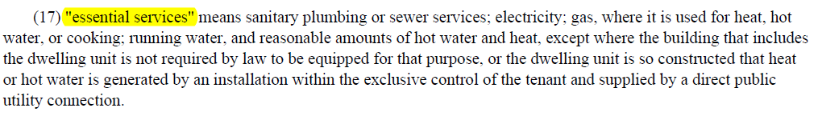
Unlawful Ouster
Another angle where essential services are at issue.
Potential liability for this if LL “willfully diminishes services to a tenant by interrupting or causing the interruption of essential services”
Only for willful acts, not negligence

Slide 35
Defensive Conditions Claims

Slide 36
Defense/Counterclaim to an Eviction
LL files for eviction after T complains about the place or withholds rent.
27-40-640 allows T to counterclaim in an action based on nonpayment
Prerequisite – LL has to have:
  Notice of the problem14 days before rent is due if the problem does not involve essential services;
  “a reasonable opportunity to make emergency repairs” if the problem involves essential services.
If LL doesn’t have notice before rent is due, violation waived.
  T might still be able to file a separate action under 27-40-610, but doesn’t get to use this as a defense/counterclaim in the eviction case.

Slide 37
What to Expect
The 790 hearing (as in 27-40-790)
  T is required to pay all rent that becomes due after the Rule is issued and all rent LL alleges is due prior to the Rule being issued.
  If the amount is in dispute, the Court should hold a hearing and determine the fair market rental value of the property at the time of the hearing.
    Presumably, this determination would apply to both the prospective rent and any back rent
The bond requirement in 27-37-130 does not apply to a residential tenancy.
  27-40-920 – provisions of Chapters 35, 37, and 39 inconsistent with the SCRLTA don’t apply to residential tenancies.
  27-40-790 – supersedes the bond requirement in 27-37-130

Slide 38
What to Expect
“Counsel, a tenant is not allowed to withhold rent…”
...a tenant is entitled to a set-off against LL’s claim for rent if LL has breached the lease or the SCRLTA. See 27-40-210(1) (defining an “action” to include a counterclaim or set-off) and 27-40-640 (affording T the right to assert defenses or counterclaims in an action for possession based on alleged nonpayment).
“well, the tenant should have filed an action to abate the rent…”
…the only reference to rent abatement based on failure to make repairs in the SCRLTA is in 27-40-790 dealing with defenses or counterclaims in an action for possession. While T could file first, they don’t have to.

Slide 39
Practice Tips
Better for CL to send the 14 day notice or 30 day security deposit demand to LL. They can testify about it, you can’t.
Get or stay current on rent if at all possible.
Pictures, pictures, pictures.
Experts?
  Fire marshal or code enforcement officer
  Inspection by pest control or mold remediation company
Beware exercises in futility.

Slide 40
Questions/Answers?
Adam Protheroe
Litigation Attorney
S.C. Appleseed Legal Justice Center
(803) 779-1113 ext. 106
adam@scjustice.org

