Slide 1
Hey that is Not Fair
Where is my Due Process

Slide 2
Due Process Clause
Amendment ____________
…No State shall make or enforce any law which shall abridge the privileges or immunities of citizens of the United States; nor shall any State deprive any person of life, liberty, or property, without_______________________; nor deny to any person within its jurisdiction the _________________________________of the laws.

Slide 3

Steps In Due Process
_____________________
_____________________
_____________________
____________________
  Finger print
  Photo
  Possible DNA
_____________________
  Guilty
  Not Guilty
  No Contest

Slide 4
Which Court Do I Go To?
___________________
  30 days up to 1 year
  Jail
  Misdemeanors
    Three classes
__________________
  1 year or more
  Prison
  Felonies
    Six classes

Slide 5
SC Court Statistics
_____________________
  Total Cases Filed
  938,060
  Total Cases Disposed 889,940
  310 Magistrates
Do the Math:
938,060 / 310 =
3,026 cases per Magistrate
_____________________
  Total Cases filed 232,741
  Total Cases Disposed 229,311
  46 Circuit Court Judges
  Do the Math:
  232,741/46 =
  5,060 cases per Judge

Slide 6
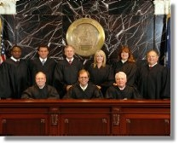
Court of Appeals
Review By Certiorari
  _______________
  _______________
Cases filed: 1,664
Cases Disposed: 1,632
Do the Math:
1,632/3 =
544

Slide 7
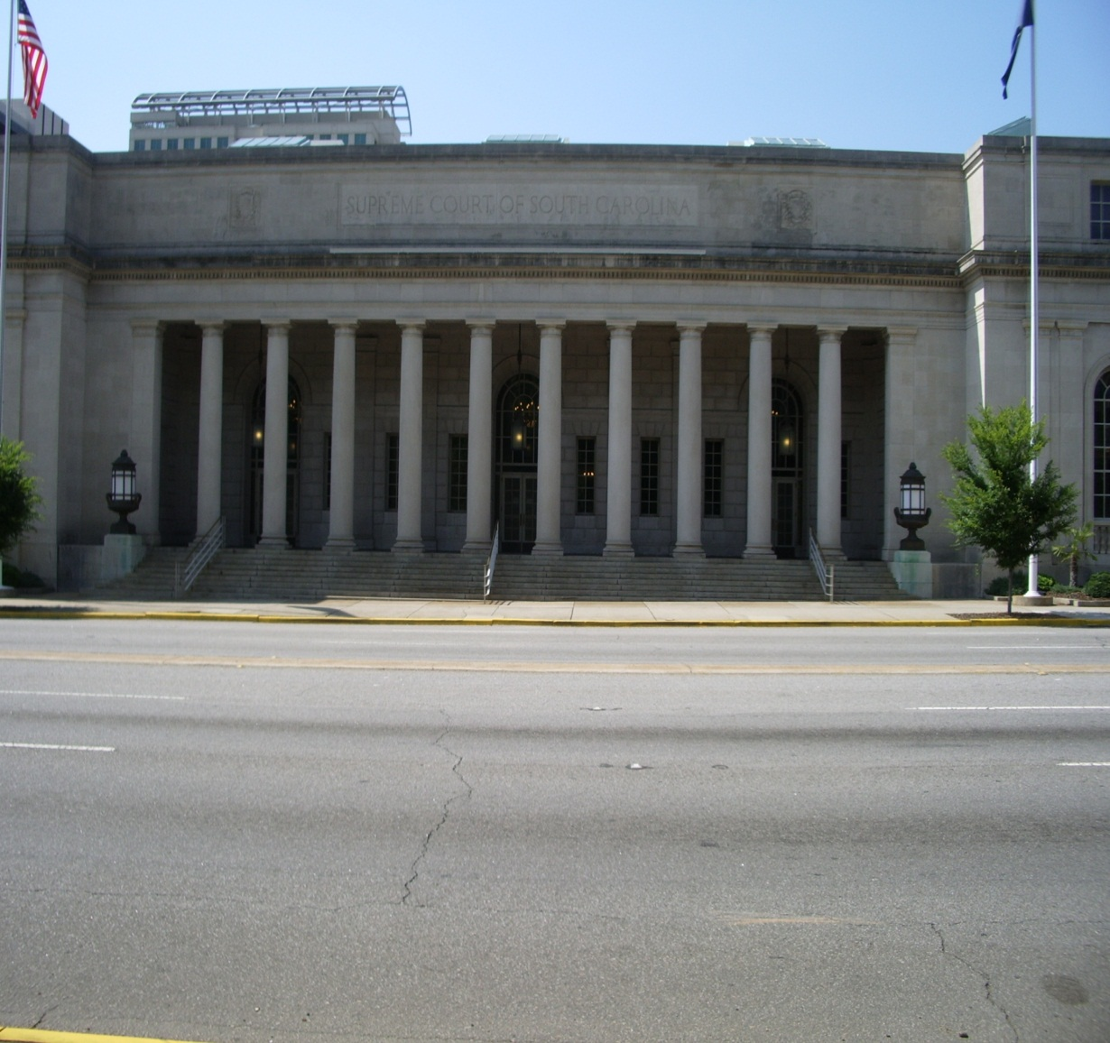
South Carolina Supreme Court
______________
  ____ Chief Justice
  _____ Associate Justices
Matters Filed: 1,427
Matters Disposed: 1,566

